Slide 1
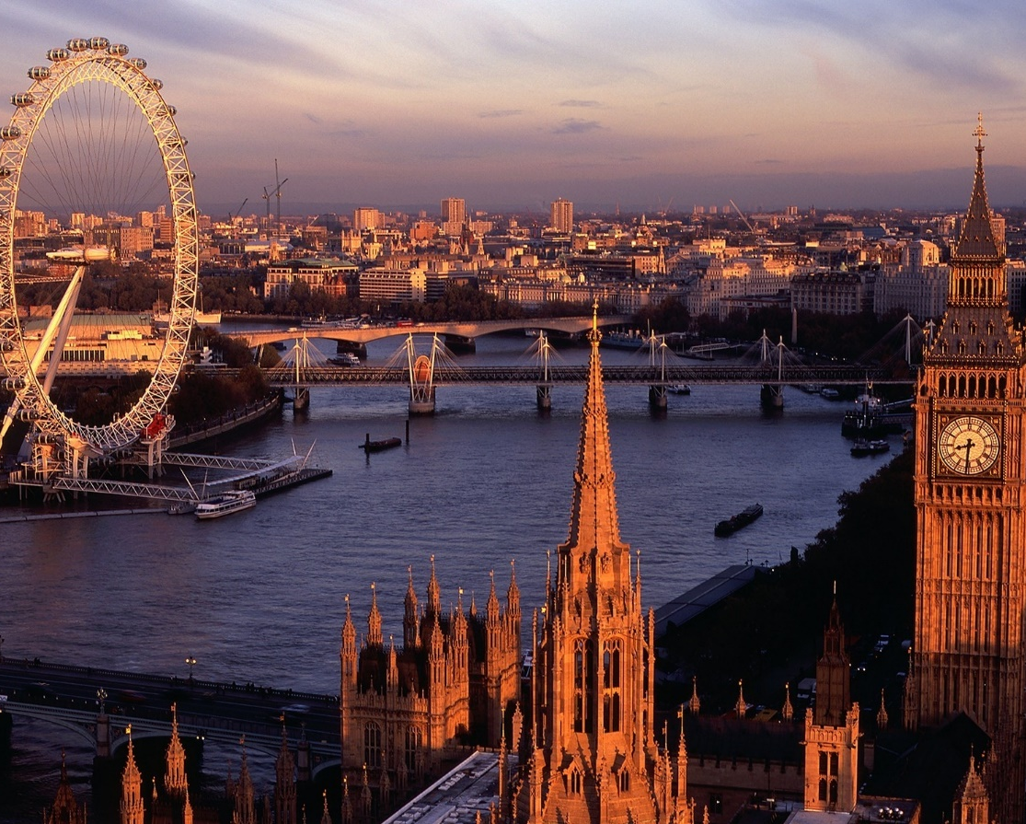
Capstone Project The Battle of Neighborhoods
By: Gargi Misra

Slide 2


Introduction/Business Problem
If you are a first-time visitor to London, it can seem like an overwhelming place because there are so many popular places to visit, such as the iconic clock tower called ‘Big Ben’, London Bridge, London Eye, Westminster Abbey, Buckingham Palace, Windsor Castle, museums, and the list goes on.
What kinds of restaurants are available in London? This project will help answer this question using Foursquare API, which is an independent location data platform that provides diverse detailed information about venues and their locations.

Slide 3
Data Description
Wikipedia is a good source to retrieve London’s list of boroughs and geopy library will be used to get coordinates for those boroughs.
Geographical data, such as boroughs (neighborhoods), coordinates (latitude and longitude) will be needed to display these locations on maps.
Information regarding venues in each borough will be obtained from Foursquare API, which is an independent location data platform that provides diverse detailed information about venues and their locations.
Data Source for London’s boroughs:
https://en.wikipedia.org/wiki/List_of_London_boroughs

Slide 4
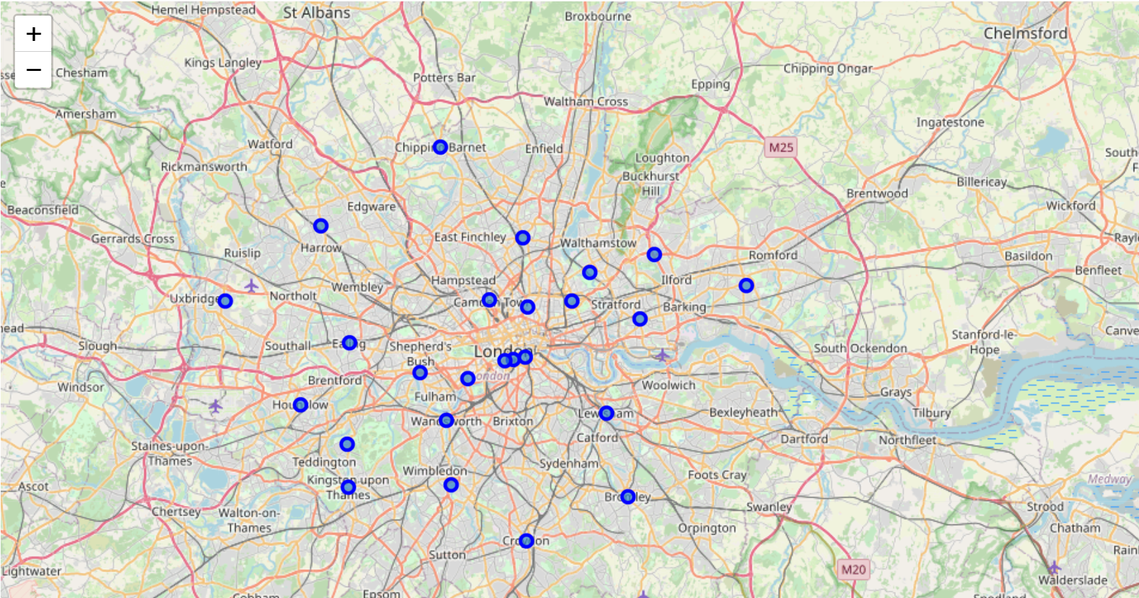
The folium library plots a map where we can see the all the boroughs in london.

Slide 5
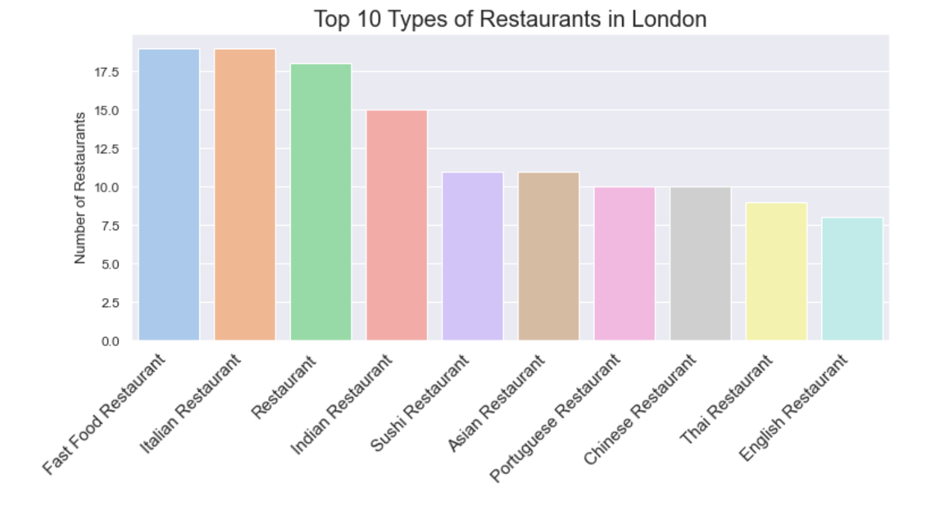
Fast food and italian restaurants have the highest number of restaurants compared to other restaurants followed by restaurant category, which is not very descriptive in the food it offers. Indian restaurant has the fourth highest frequency of restaurants in london.

Slide 6
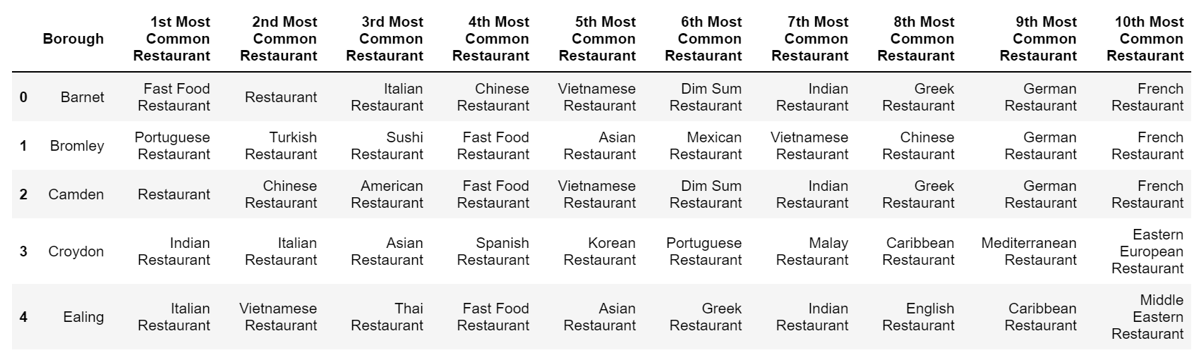
Top 10 most common venues for the first 5 boroughs

Slide 7
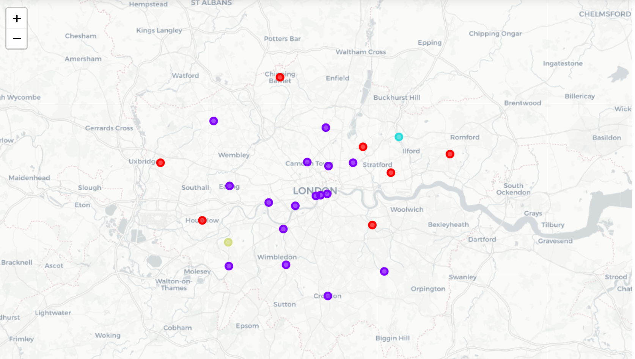
4 clusters of 10 most common restaurant types in London

Slide 8
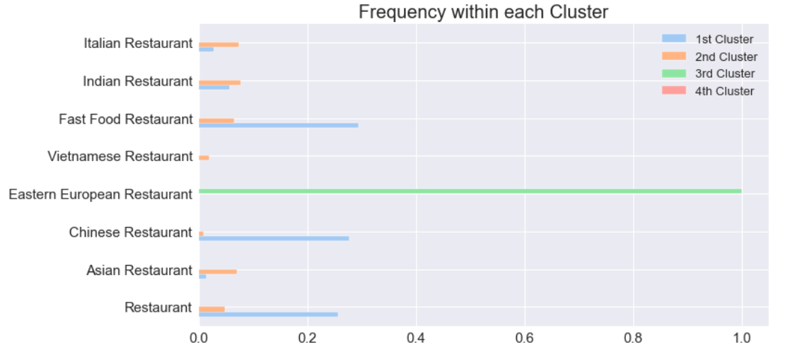
Comparing Clusters

Slide 9
Conclusion
Cluster 2 has the highest number of boroughs and has the most restaurants and a variety of cuisine types. Kingston upon Thames has the most variety in the restaurants (27) followed by Islington (26).
Each borough has the most common restaurant which may be same or different from other boroughs.

